Slide 1

Effects of Berry Curvature on Thermoelectric Transport
Archisman Panigrahi
UG 4th Year
24th June 2021
Supervisor: Prof. Subroto Mukerjee, Dept. of Physics, IISc

Slide 2
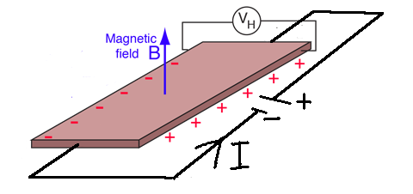
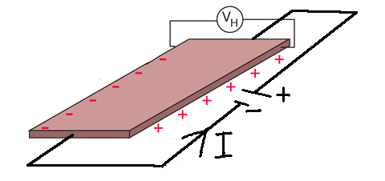
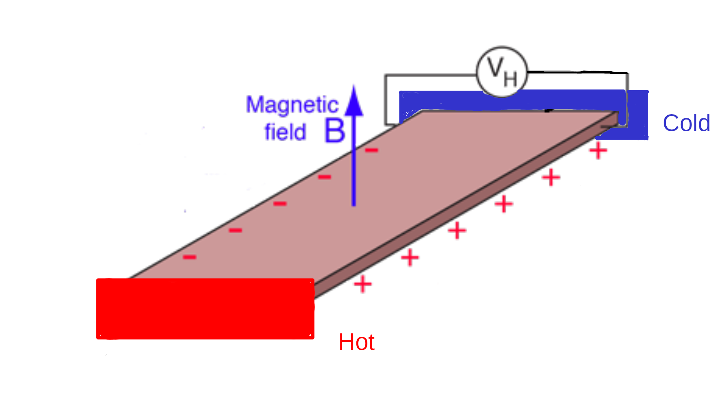
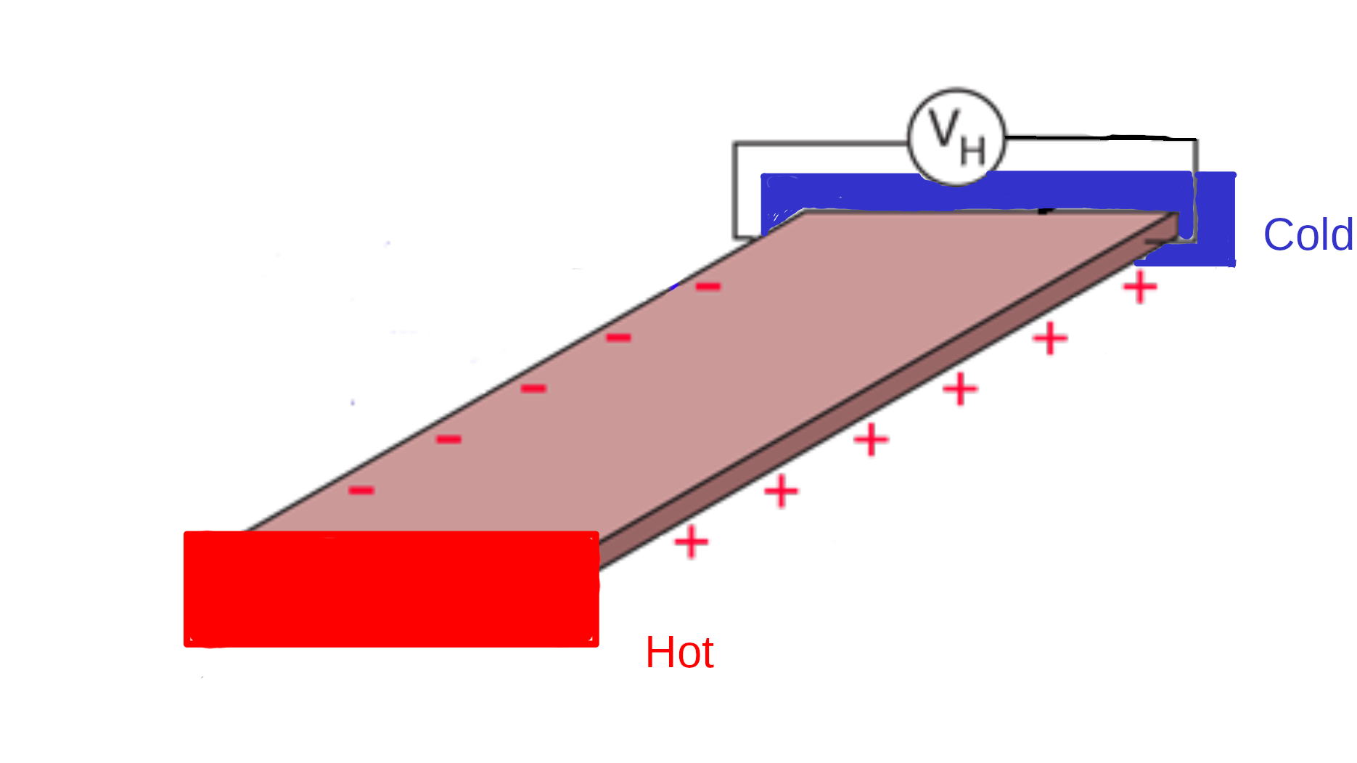
Why is this interesting?
There can be a transverse Hall voltage without a magnetic field
N. Nagaosa, J. Sinova, S. Onoda, A. H. MacDonald, and N. P. Ong
Rev. Mod. Phys. 82, 1539 (2010)
Anomalous Hall Effect
Nernst Effect: Hall like response for a temperature gradient
Electrically insulating temperature reservoirs
Kamran Behnia and Hervé Aubin Rep. Prog. Phys.79 046502 (2016)
Anomalous Nernst Effect

Slide 3
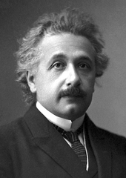
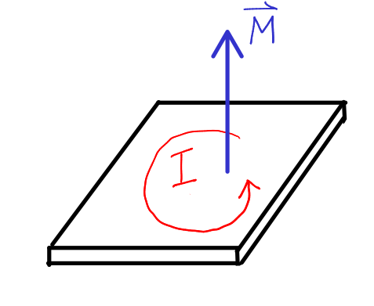
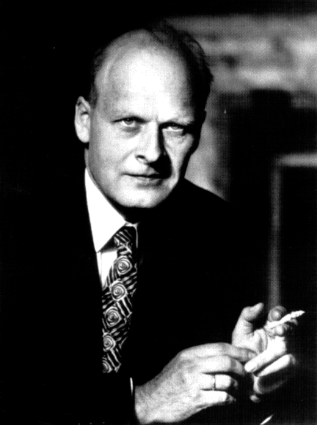
Thermoelectric transport: Einstein and Onsager relations
Local current densities
Einstein relation:
Onsager relation:
(experimental)
N. R. Cooper, B. I. Halperin, and I. M. Ruzin. PRB 55 2344 (1997)

Slide 4
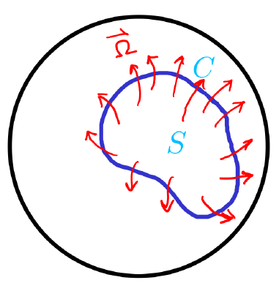
Geometric phase and Berry Curvature
M. V. Berry. Proceedings of the Royal Society A. 392 1802 (1984)
Time dependent Hamiltonian
Space of
Stokes’ theorem:
Like magnetic field, but in parameter space

Slide 5
Berry Curvature in reciprocal space
Bloch wavefunctions in periodic potential
  Effective Schrödinger equation
Crystal momentum changes with electromagneic field
Time evolution

Slide 6
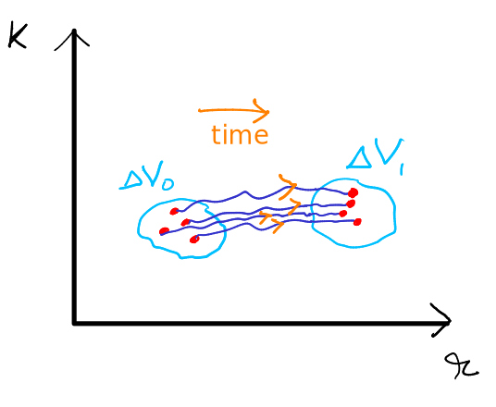
Effects of Berry curvature
Ming-Che Chang and Qian Niu PRL 75, 1348 (1995),
Daniel C. Ralph. arXiv: 2001.04797
The semiclassical equation of velocity is modified
                Decoupled
(2D)
Phase space density is modified
Anomalous velocity
(2D)
is a constant of motion
Phase space volume element
Di Xiao, Junren Shi, and Qian Niu. PRL 95, 137204 (2005)

Slide 7
When do we get a non-zero Berry Curvature?
If inversion symmetry holds
If time reversal symmetry holds
When both hold simultaneously, Berry curvature is identically zero.

Slide 8


Boltzmann Transport framework
        Classical charge and energy currents
        Semiclassical framework
Locally averaged
Current density
Heat current: From 1st law of thermodynamics,

Slide 9
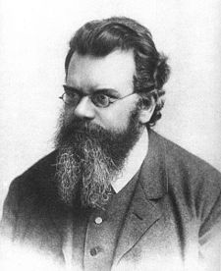
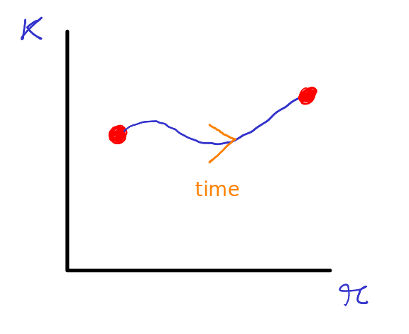
Boltzmann Transport Equation
In equilibrium, is the Fermi distribution.
The external fields are small, and it deviates slightly from
the Fermi distribution
The system tries to attain equilibrium, with a relaxation time
We assume that the more the distribution deviates, the faster it would try to return to equilibrium, relaxation time approximation.

Slide 10
Boltzmann Transport Equation
In steady-state, and homogeneous fields, the equation becomes,
Why is the perturbation theory valid?
Dimension analysis: this term = the first term, is the cyclotron frequency
This is small compared to the first term when
If then the critical field is ~ 570 T
Why even consider this term, then??

Slide 11
Boltzmann Transport Equation
In steady-state, and homogeneous fields, the equation becomes,
1. Dantas, R.M.A., Peña-Benitez, F., Roy, B. et al. J. High Energ. Phys. 2018, 69 (2018).
2. Ki-Seok Kim, Heon-Jung Kim, and M. Sasaki Phys. Rev. B 89, 195137 (2014)
3. O. Pal, B. Dey, T. K. Ghosh arXiv:2102.03779 [cond-mat.mes-hall]
Einstein and Onsager
Relations are satisfied
The solution, with
Regular Ohmic transport
New result (2D)
Regular Hall, Nernst

Slide 12
Which all terms contribute
2nd order
0, as it should be without any external field
For a filled band,
Chern number, integer
Independent of scattering!!

Slide 13
Which all terms contribute
For a filled band, quantized!!
This is not the (usual) quantum Hall effect
There is an issue here
Independent of scattering!!

Slide 14
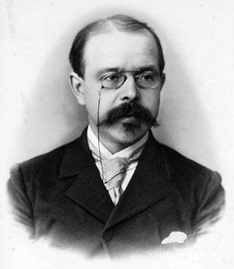
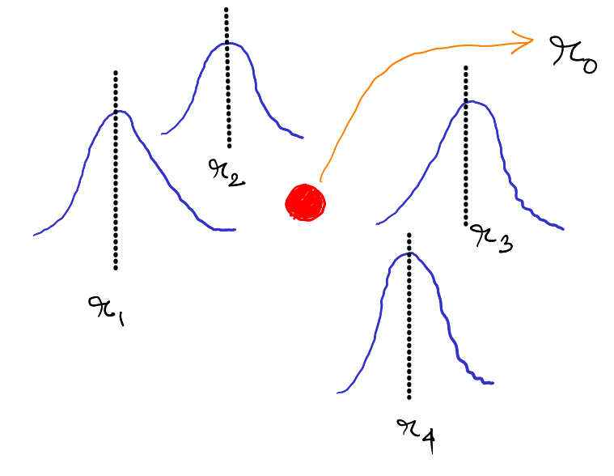
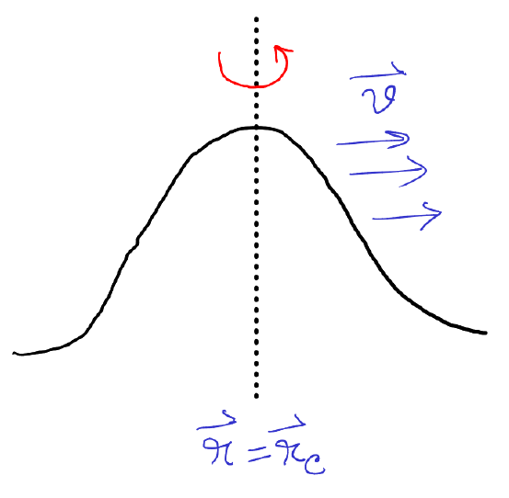
Issue
(Nernst)
Apparently, a temp gradient or
a chemical potential gradient
cannot give rise to anomalous Hall effect
No term like and
☹️
☹️
☹️
What we missed:
The wavepackets are not localized
Circulating magnetization currents
Orbital magnetic moment
Di Xiao, Yugui Yao, Zhong Fang, and Qian Niu. PRL 97, 026603 (2006)

Slide 15
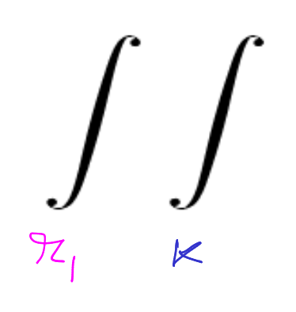
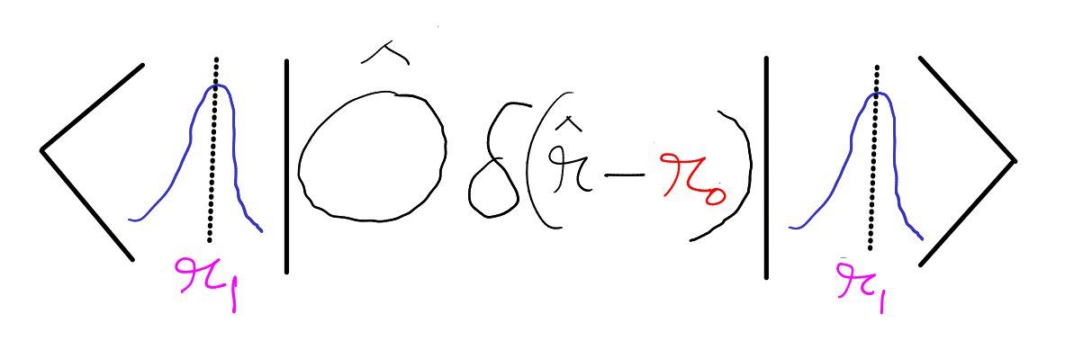
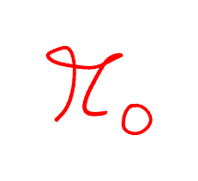
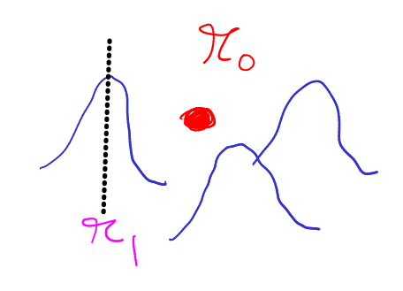
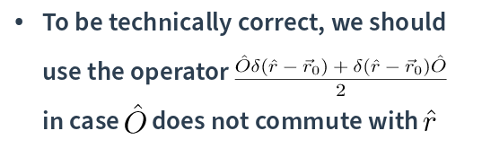
Wavepackets are not strictly localized

Slide 16
To calculate electric current, we use
This result can be found in existing scientific literature without any derivation, I was able to derive it
Similarly, for energy current
Di Xiao, Yugui Yao, Zhong Fang, and Qian Niu. PRL 97, 026603 (2006)

Slide 17
Effects of orbital magnetization
Energy eigenvalues are modified
Net magnetization can be obtained from the Free energy
Phase space density correction is important
Di Xiao, Yugui Yao, Zhong Fang, and Qian Niu. PRL 97, 026603 (2006)

Slide 18
Transport current
Now we are ready to calculate the transport electric current
Regular Ohmic, Hall, Nernst
Anomalous
Hall
Anomalous Nernst
Di Xiao, Yugui Yao, Zhong Fang, and Qian Niu. PRL 97, 026603 (2006)

Slide 19
How about Onsager relation?
We can similarly define energy magnetization,
Regular
response
Di Xiao, Yugui Yao, Zhong Fang, and Qian Niu.
PRL 97, 026603 (2006)
☹️
Anomalous

Slide 20
Possible resolution for the Einstein relation to hold
~ sum of Chern numbers of filled bands
New result, not found in existing
scientific literature
, finite even at zero temperature
Raffaele Resta 2010 J. Phys.: Condens. Matter 22 123201 : Showed a similar relation for circulating electric current
Contribution is zero for trivial states, and each topological state contributes
to the bound energy current
In 2D

Slide 21
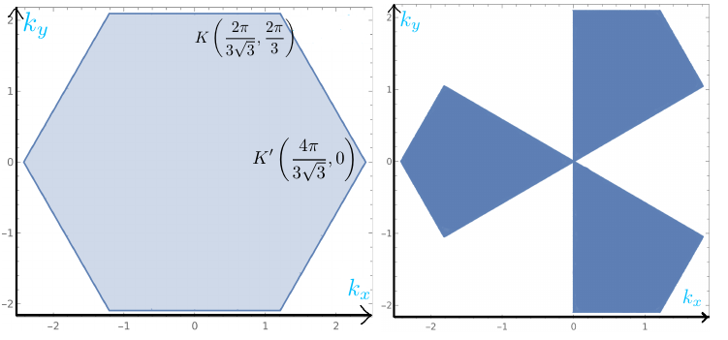
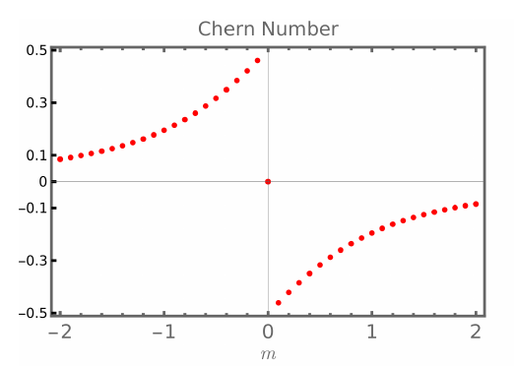
Some materialistic examples: Valley Polarization
Monolayer graphene and Transition Metal Dichalcogenides
without band gap
Time Reversal Symmetry
Electrons can be made to selectively occupy valleys with circularly polarized light
1. A. Friedlan and M. M. Dignam PRB 103, 075414 (2021) (theory) 2. McIver, J.W., Schulte, B., Stein, FU. et al. Nat. Phys. 16, 38–41 (2020) (experimental work)

Slide 22
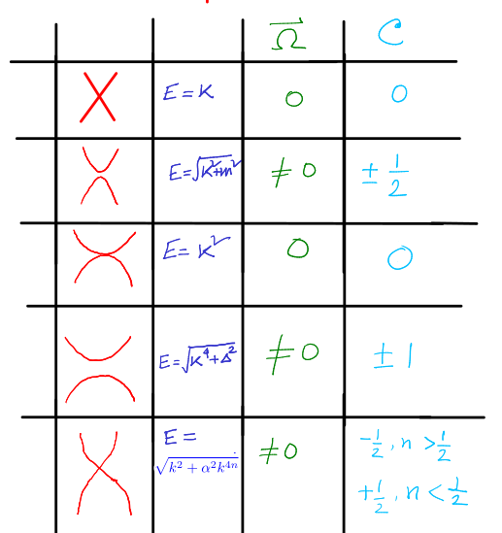
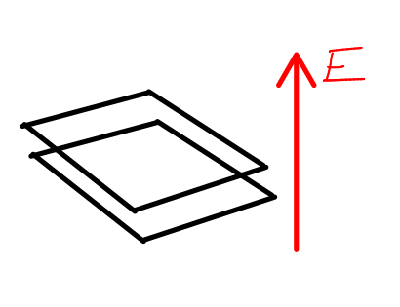
Results for valley Chern number in continuum limit
Monolayer graphene
Monolayer graphene with broken sublattice symmetry
(Boron Nitride)
Bilayer graphene
Biased Bilayer graphene

Slide 23
New results
The condition on the energy magnetization for Einstein relation to hold for anomalous Heat current, and found an interpretation to that in terms of the number of circulating topological states.
Solution of Boltzmann transport equation upto linear order in 2D, that captures the effects of Berry curvature in regular Ohmic, regular Hall and regular Nernst effects.
This is relevant in biased bilayer graphene, where there is non zero Berry curvature, but anomalous response is zero due to Time Reversal Symmetry.

Slide 24
Apart from that
Filled all the missing steps in the formalism developed in several papers
Found an explicit derivation for
which is not available in existing literature
Studied valley Chern numbers of several microscopic models

Slide 25
Thank you

Slide 26
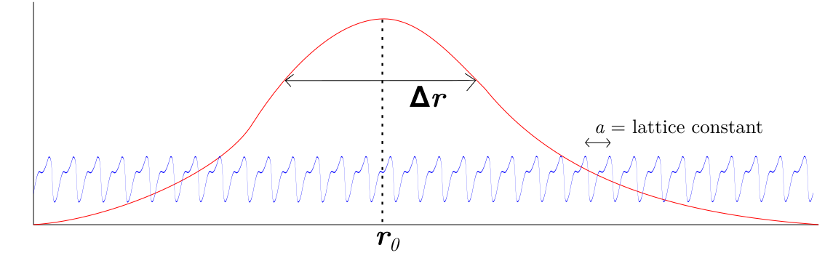
Appendix: Construction of Bloch wavepacket, and its evolution
  Wavepacket
                Bloch eigenfunction

